Slide 1
Chapter 6
International Terms of Trade with New 2020 Incoterms

Slide 2
International Terms of Trade—
Incoterms® Rules
International Commerce Terms
Understanding Incoterms® Rules
Overview of all 11 Incoterms® Rules
Electronic Data Interchange
Common Errors in Incoterms® Rules Usage
Incoterms® Rules as a Marketing Tool

Slide 3
International Terms of Trade—
Incoterms® Rules
IMPORTANT NOTE:
Incoterms are frequently reviewed and updated. The most recent version is dated 2020, and will be implemented on January 1, 2020.
This PowerPoint presentation is slightly different from the textbook and takes into account two modifications from Incoterms 2010:
The Delivered At Terminal (DAT) Incoterms® rule is now called Delivered At Place, Unloaded (DPU)
The Carriage and Insurance Paid to (CIP) Incoterms® rule now requires insurance Coverage A of the Institute Cargo Clauses.

Slide 4
International Terms of Trade
For each international sale, it is important to determine, who — of the exporter or the importer — is responsible for:
Pre-carriage, the domestic transportation in the exporting country
Main carriage, the international transportation between the exporting country and the importing country
On-carriage, the domestic transportation in the importing country
The risks involved in international transportation
Customs clearance in the importing country

Slide 5
International Commerce Terms Incoterms® Rules
In 1936, the International Chamber of Commerce developed International Commerce Terms rules (or Incoterms® rules) that formalized these responsibilities. Incoterms rules were revised in 1953, 1967, 1980, 1990, 2000, and 2010.
The latest version of Incoterms® rules is dated 2020, and was implemented 01/01/2020.
Incoterms rules follow international trade practices and are always reflecting the way shipping is conducted. The changes implemented in 2010 were significant, but were designed to facilitate the division of responsibilities between the exporter and the importer. The 2020 version made only two slight modifications.

Slide 6
Incoterms® Rules 2020
Incoterms® rules formally define the following aspects of an international sale:
  Which tasks will be performed by the exporter
  Which tasks will be performed by the importer
  Which activities will be paid by the exporter
  Which activities will be paid by the importer
  The exact point at which the responsibility for the goods transfers from the exporter to the importer
There are 11 different Incoterms® rules, all abbreviated with a 3-letter acronym, such as EXW, DAP, FOB, and so on.

Slide 7
Choice of an Incoterms® Rule
Choosing the correct Incoterms® rule depends on which export strategy a company is following. The following factors are particularly important:
  The type of product being sold (weight, volume, perishability, value, sensitivity to temperature changes, and so on)
  The method of shipment
  The ability and willingness of either of the exporter and importer to perform the tasks involved
  The amount of trust placed by either of the parties in the other party

Slide 8
Incoterms® Rules
The International Chamber of Commerce specifies that there are two groups of Incoterms rules:
Seven Incoterms rules that can be used for any means of transportation (ocean, road, air, train).
Four Incoterms rules that can only be used for ocean transportation (these are the oldest terms of trade).

Slide 9
Incoterms® Rules
Any mode of Transportation
EXW
Ex-Works
FCA
Free Carrier
CPT
Carriage Paid To
CIP
Carriage and Insurance Paid To
DAP
Delivered At Place
DPU
Delivered At Place, Unloaded
DDP
Delivered Duty Paid
FAS
Free Alongside Ship
FOB
Free On Board
CFR
Cost and Freight
CIF
Cost, Insurance and Freight
Ocean Transportation

Slide 10
Incoterms® Rules
Each Incoterms rule has:
A scope — The type of products for which it can be used
A modality — The mode of transport for which it can be used
A syntax — The way it has to be stated on invoices and paperwork
Each Incoterms rule defines:
The responsibilities of the exporter
The responsibilities of the importer
A specific transfer point at which the responsibilities for the goods shifts from the exporter to the importer

Slide 11
Ex-Works (EXW)
Scope
  Ex-Works can be used for any type of goods. However, in the Incoterms® rules 2020, the International Chamber of Commerce clearly wants EXW to be used for small packages that are picked up by express packages services, such as FedEx or DHL.
Modality
  Ex-Works can be used for any mode of transportation.
Syntax
  EXW [Address in the City of Departure where goods are made available], Incoterms ® 2020.
EXW · 2400 Progress Drive, Poughkeepsie,
New York 12601, USA, Incoterms® 2020.

Slide 12
Ex-Works (EXW)
Responsibilities of the Exporter
  The exporter must package the goods for the international voyage and provide the importer with the documents necessary to clear the goods for export in the exporting country and to clear customs in the importing country.
Responsibilities of the Importer
  The importer must do everything else.
Point at which the responsibility for the good shifts from exporter to importer
  When the exporter makes the goods available to the importer.

Slide 13

The ICC recommends that EXW be used only for small packages

Slide 14
Free Carrier (FCA)
Scope
  Free Carrier can be used for any type of goods.
Modality
  Free Carrier can be used for any mode of transportation.
Syntax
  FCA [Address in the City of Departure where goods are delivered to carrier], Incoterms ® 2020.
FCA · Bâtiment B, 46 Allée Corbière, F-81000 Castres, France, Incoterms® 2020

Slide 15
Free Carrier (FCA)
Under the FCA Incoterms® rule, there are two choices regarding the delivery of the goods. The exporter and importer can agree on:
FCA Exporter’s Premises
  The exporter loads the goods at its place of business on a truck (means of conveyance) provided by the importer.
FCA Carrier’s Premises
  The exporter loads the goods on its own truck and delivers them to the carrier’s place of business, still loaded on the truck. It is the responsibility of the carrier to unload them from the truck.

Slide 16
Free Carrier (FCA)
Responsibilities of the Exporter
  The exporter must package the goods for the international voyage, provide the importer with the documents necessary to clear customs in the importing country, and deliver the goods on the truck either at its own place of business or the carrier’s place of business.
Responsibilities of the Importer
  The importer must do everything else.
Point at which the responsibility for the good shifts from exporter to importer
  When the goods are delivered to the carrier, loaded on the truck.

Slide 17
Carriage Paid To
Scope
  Carriage Paid To can be used for any type of product.
Modality
  Carriage Paid To can be used for any mode of transportation.
Syntax
  CPT [Address in the City of Destination where goods are delivered], Incoterms ® 2020.
CPT · Graacher Straße 20, Köln,
Deutschland D-50969, Incoterms® 2020.

Slide 18
Carriage Paid To (CPT)
Responsibilities of the Exporter
  The exporter must package the goods for the international voyage, provide the importer with the documents necessary to clear Customs in the importing country, as well as arrange and pay for pre-carriage, main carriage and on-carriage to the city of destination.
Responsibilities of the Importer
  The importer must do everything else.
Point at which the responsibility for the good shifts from exporter to importer
  When the exporter delivers the goods to the first carrier in the exporting country.

Slide 19
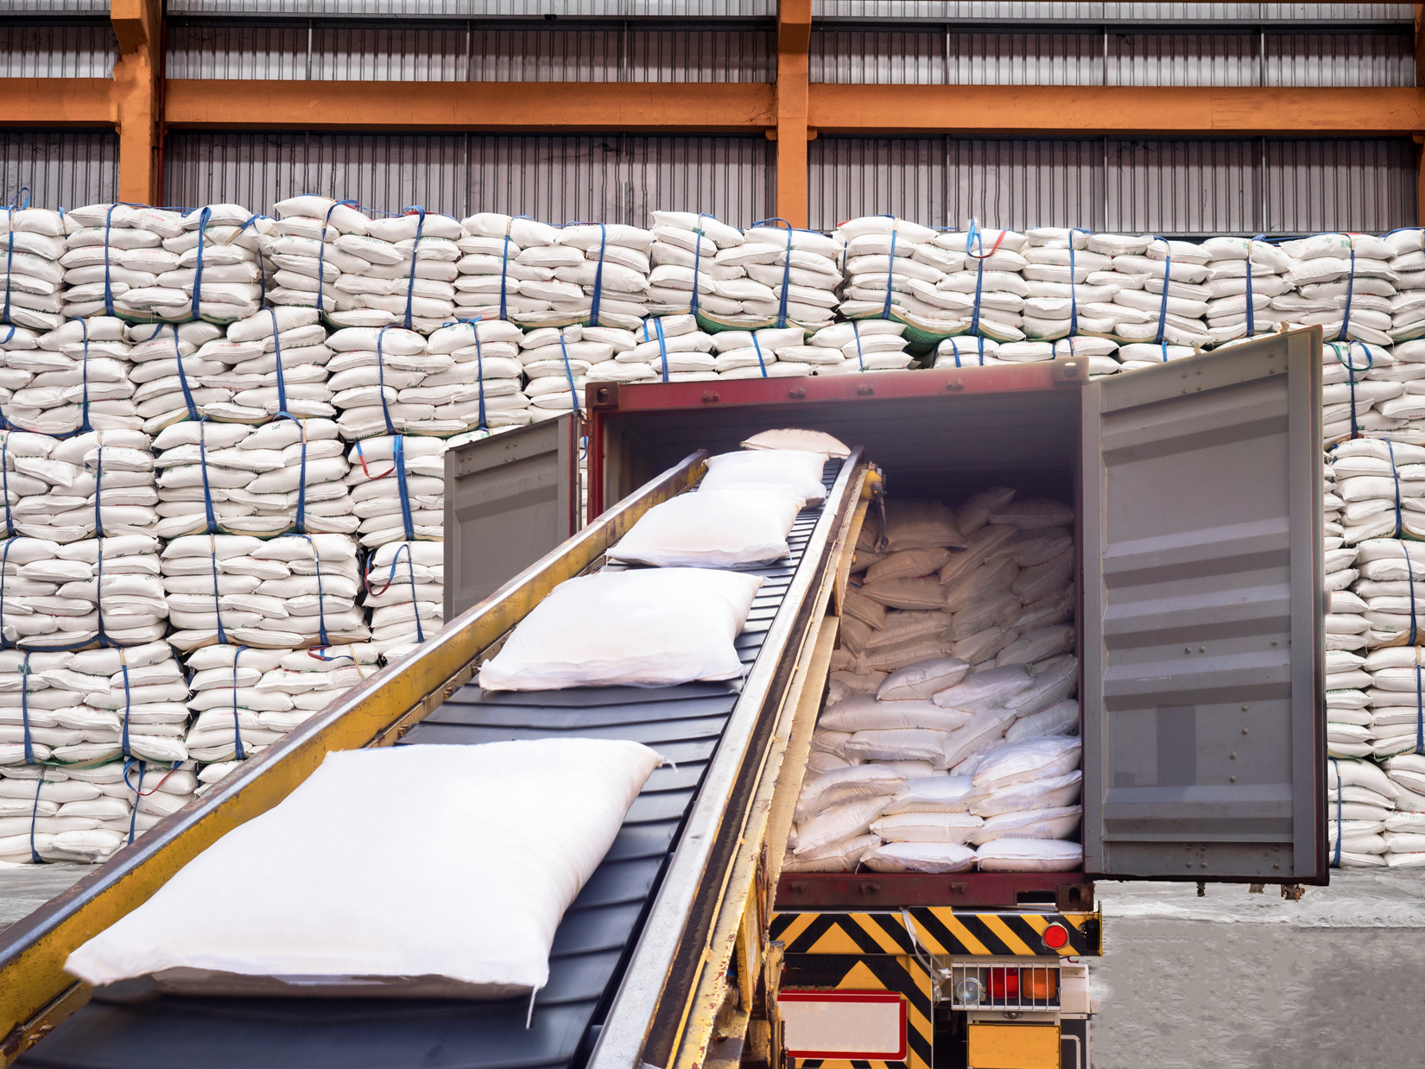
Under CPT, delivery takes place when goods are loaded in the first means of conveyance

Slide 20
Carriage and Insurance Paid To (CIP)
Scope
  Carriage and Insurance Paid To can be used for any type of product.
Modality
  Carriage and Insurance Paid To can be used for any mode of transportation.
Syntax
  CIP [Address in the City of Destination where goods are delivered], Incoterms ® 2020.
CIP · Ulitsa Poruchik Nedelcho Bonchev,
Sofia, Bulgaria, Incoterms® 2020

Slide 21
Carriage and Insurance Paid To (CIP)
Responsibilities of the Exporter
  The exporter must package the goods for the international voyage, provide the importer with the documents necessary to clear Customs in the importing country, as well as arrange and pay for pre-carriage, main carriage, on-carriage and insurance to the city of destination.
Responsibilities of the Importer
  The importer must do everything else.
Point at which the responsibility for the good shifts from exporter to importer
  When the exporter delivers the goods to the first carrier in
  the exporting country.

Slide 22
Carriage and Insurance Paid To (CIP)
Insurance under CIP
  Under the CIP Incoterms® rule, the exporter must provide insurance for the goods that provides coverage A of the Institute Cargo Clauses.
  The amount of insurance is always 110 percent of the value of the goods.
Important change
  Under Incoterms 2010, the exporter had to provide Coverage C of the Institute Cargo Clauses, but this was changed under Incoterms 2020.

Slide 23
Delivered At Place (DAP)
Scope
  Delivered At Place can be used for any type of product.
Modality
  Delivered At Place can be used for any mode of transportation.
Syntax
  DAP [Address in the City of Destination where goods are delivered], Incoterms ® 2020.
DAP · 97 Brisbane Street, Sydenham 8023,
New Zealand, Incoterms® 2020.

Slide 24
Delivered At Place (DAP)
The Delivered At Place Incoterms® rule was created in 2010. It was meant to replace the Delivered Duty Unpaid (DDU) Incoterms® rule that had been in existence until 2010.
Under the DAP Incoterms® rule, the exporter and the importer generally agree to use a location in the importing country. However they could agree on a location in the exporting country, or one in a country through which the goods will transit.

Slide 25
Delivered At Place (DAP)
Responsibilities of the Exporter
  The exporter must package the goods for the international voyage, provide the importer with the documents necessary to clear Customs in the importing country, as well as arrange and pay for pre-carriage, main carriage and on-carriage to the city of destination.
Responsibilities of the Importer
  The importer must do everything else.
Point at which the responsibility for the good shifts from exporter to importer.
  When the exporter delivers the goods to the place of delivery, still loaded on the mode of transportation.

Slide 26
Delivered at Place, Unloaded (DPU)
Scope
  Delivered at Place, Unloaded can be used for any type of product, but it is designed for containerized cargo.
Modality
  Delivered at Place, Unloaded can be used for any mode of transportation.
Syntax
  DPU [Address in the City of Destination where goods are delivered], Incoterms ® 2020.
DPU · Paranaguá Container Terminal, Avenida Portuária, Paranaguá, Parana 83206-410, Brazil,
Incoterms® 2020.

Slide 27
Delivered At Place, Unloaded (DPU)
The Delivered At Place, Unloaded Incoterms® rule was created in 2020. It replaces the Delivered At Terminal (DAT) Incoterms® rule that had been created in 2010.
The DPU rule is meant to be used for containerized cargo delivered to a port, and to replace the maritime cargo terms (FCA, FOB, CFR, CIF), which the ICC wants to reserve for non-containerized cargo.
Under the DPU Incoterms® rule, the exporter and the importer can agree on a terminal that is located in the exporting country, or one located in the importing country, or yet one located in a country through which the goods will transit.
The DPU Incoterms® rule reflects the practices followed by companies that utilize containers in international trade. They deliver containers to terminals in the country of export and collect containers at terminals located in the country of import.

Slide 28
Delivered At Place, Unloaded (DPU)
Responsibilities of the Exporter
  The exporter must package the goods for the international voyage, provide the importer with the documents necessary to clear Customs in the importing country, as well as arrange and pay for transportation to the terminal at which the goods are to be delivered.
Responsibilities of the Importer
  The importer must do everything else.
Point at which the responsibility for the good shifts from exporter to importer
  When the exporter delivers the goods, unloaded from the mode of transportation, to the terminal.

Slide 29
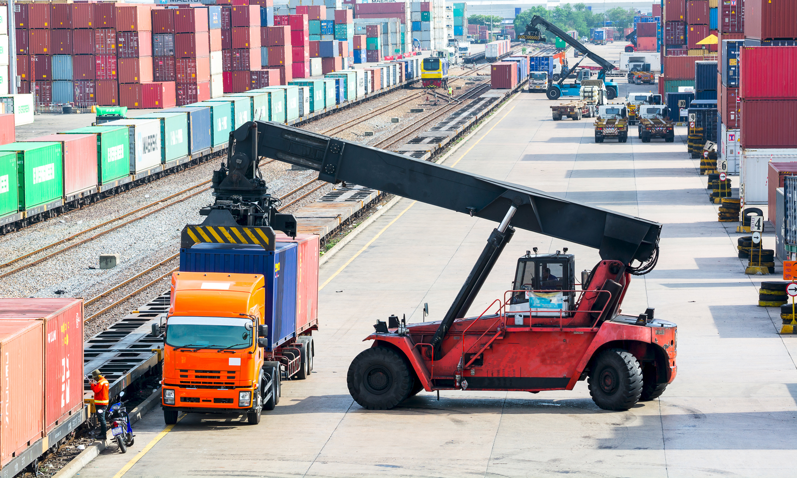
Under DPU, delivery takes place when goods are unloaded in the terminal or location.

Slide 30
Delivered Duty Paid (DDP)
Scope
  Delivered Duty Paid can be used for any type of product.
Modality
  Delivered Duty Paid can be used for any mode of transportation.
Syntax
  DDP [Address in the City of Destination where goods are delivered], Incoterms ® 2020.
DDP · Kopparbergsgatan 226, Malmö 214 44, Sverige/Sweden, Incoterms® 2020.

Slide 31
Delivered Duty Paid (DDP)
Responsibilities of the Exporter
  The exporter must package the goods for the international voyage, arrange and pay for pre-carriage, main carriage and on-carriage to the city of destination, and clear Customs in the importing country.
Responsibilities of the Importer
  The importer must unload the goods from the means of conveyance.
Point at which the responsibility for the good shifts from exporter to importer
  When the exporter delivers the goods to the delivery location, still loaded onto the mode of transportation.

Slide 32
Free Alongside Ship (FAS)
Scope
  Free Alongside Ship can be used for any type of product. However, the International Chamber of Commerce would like FAS to be used only for non-containerized cargo.
Modality
  Free Alongside Ship can only be used for ocean transportation.
Syntax
  FAS [Address of the dock in the Port of Departure where the goods are delivered], Incoterms ® 2020.
FAS · Waalhaven Noordzijde 2089, Rotterdam,
3089KM, The Netherlands, Incoterms® 2020.

Slide 33
Free Alongside Ship (FAS)
Responsibilities of the Exporter
  The exporter must package the goods for the international voyage, provide the importer with the documents necessary to clear Customs in the importing country, as well as arrange and pay for pre-carriage to the port of departure.
Responsibilities of the Importer
  The importer must do everything else.
Point at which the responsibility for the good shifts from exporter to importer
  When the exporter delivers the goods to the port of departure, unloaded from the mode of transportation.

Slide 34
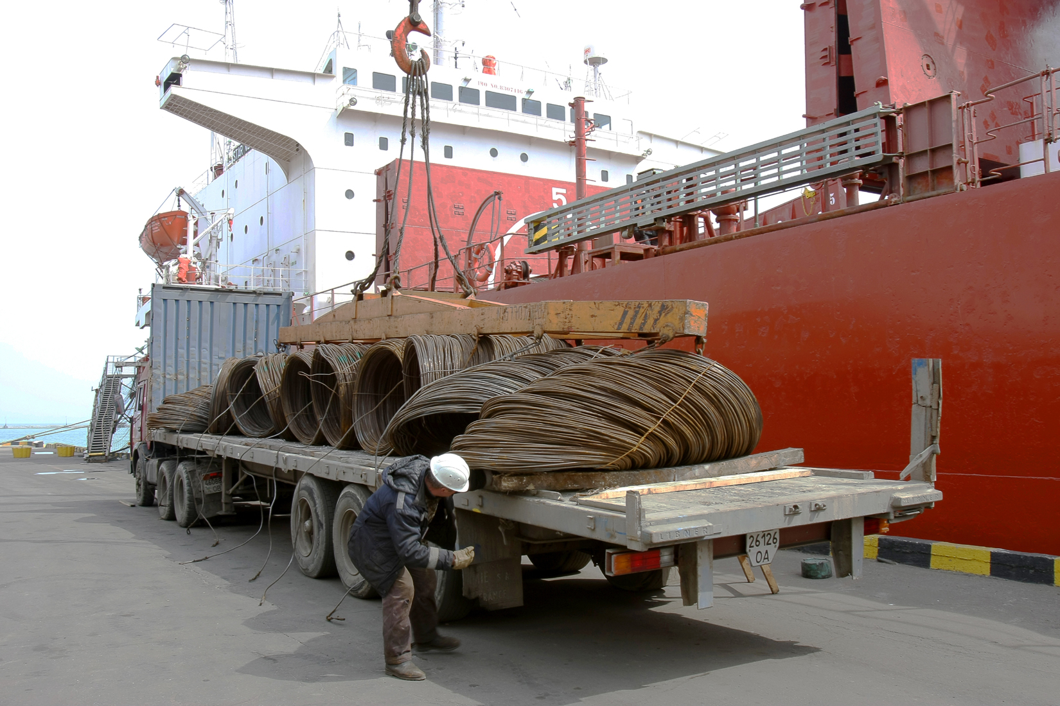
Under FAS, delivery takes place when goods arrive alongside the ship in the port of departure

Slide 35
Free On Board (FOB)
Scope
  Free On Board can be used for any type of product. However, the International Chamber of Commerce would like FAS to be used only for non-containerized cargo.
Modality
  Free On Board can only be used for ocean transportation.
Syntax
  FOB [dock (or ship) in the Port of Departure where the goods are delivered], Incoterms ® 2020.
FOB · Breakbulk Terminal, 660 Duncan Road,
Cape Town, South Africa, Incoterms® 2020.

Slide 36
Free On Board (FOB)
Responsibilities of the Exporter
  The exporter must package the goods for the international voyage, provide the importer with the documents necessary to clear Customs in the importing country, arrange and pay for pre-carriage to the port of departure and loading onto the ship.
Responsibilities of the Importer
  The importer must handle everything else.
Point at which the responsibility for the good shifts from exporter to importer
  When the exporter delivers the goods onboard the ship in the port of departure.

Slide 37
Cost and Freight (CFR)
Scope
  Cost and Freight can be used for any type of product. However, the International Chamber of Commerce would like FAS to be used only for non-containerized cargo.
Modality
  Cost and Freight can only be used for ocean transportation.
Syntax
  CFR [Address of the dock in the Port of Destination where goods are delivered], Incoterms ® 2020.
CFR · ENL Multi-purpose Terminal, Apapa Wharf,
Lagos,Nigeria, Incoterms® 2020.

Slide 38
Cost and Freight (CFR)
Responsibilities of the Exporter
  The exporter must package the goods for the international voyage, provide the importer with the documents necessary to clear Customs in the importing country, as well as arrange and pay for pre-carriage and main carriage to the port of destination.
Responsibilities of the Importer
  The importer must do everything else.
Point at which the responsibility for the good shifts from exporter to importer
  When the exporter delivers the goods onboard the ship in the port of departure.

Slide 39
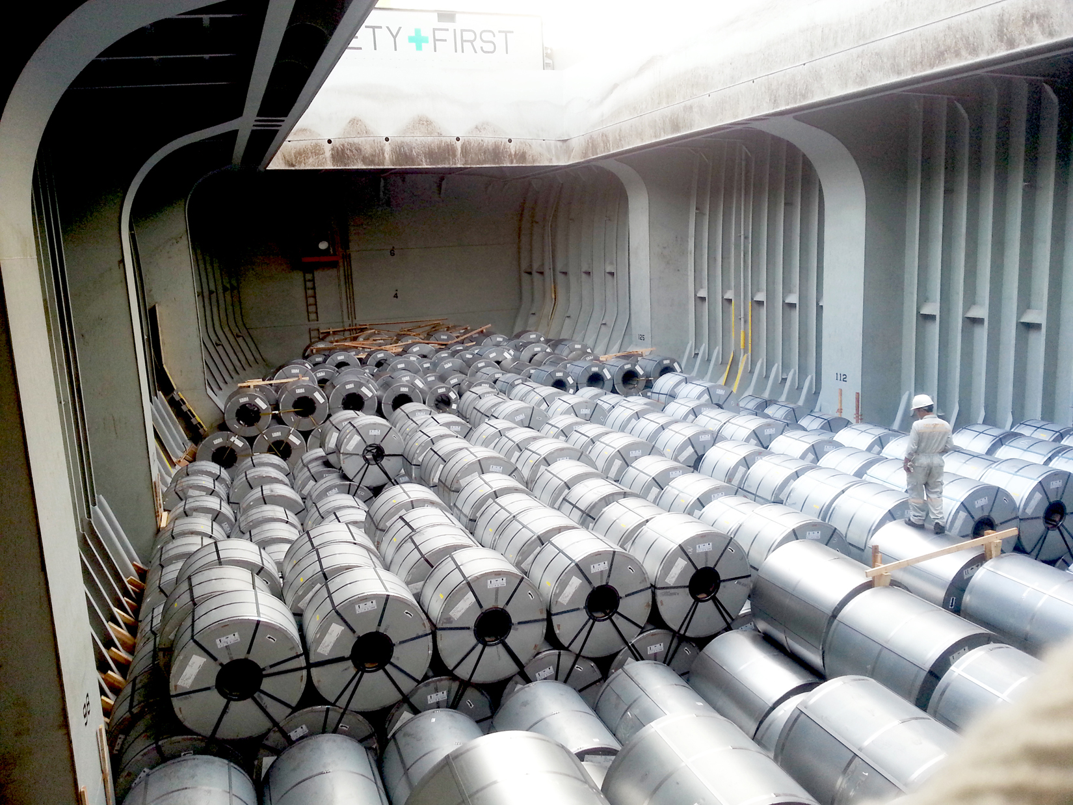
Under CFR, delivery takes place when goods are placed onboard the ship

Slide 40
Cost, Insurance and Freight (CIF)
Scope
  Cost Insurance and Freight can be used for any type of product. However, the International Chamber of Commerce would like FAS to be used only for non-containerized cargo.
Modality
  Cost Insurance and Freight can only be used for ocean transportation.
Syntax
  CFR [Address of the dock in the Port of Destination where goods are delivered], Incoterms ® 2020.
CIF · Naigai Lines, 176 Higashi-Machi, Chuo-Ku,
Kobe 650-0031, Hyogo, Japan, Incoterms® 2020.

Slide 41
Cost, Insurance and Freight (CIF)
Responsibilities of the Exporter
  The exporter must package the goods for the international voyage, provide the importer with the documents necessary to clear Customs in the importing country, as well as arrange and pay for pre-carriage, main carriage and insurance to the port of destination.
Responsibilities of the Importer
  The importer must do everything else.
Point at which the responsibility for the good shifts from exporter to importer
  When the exporter delivers the goods onboard the ship in the port of departure.

Slide 42
Cost, Insurance and Freight (CIF)
Insurance under CIF
  Under the CIF Incoterms® rule, the exporter must provide insurance for the goods, but it is minimum insurance (coverage C of the Institute Cargo Clauses).
  The amount of insurance is always 110 percent of the value of the goods.
Incoterms® rule Variant
  It is possible for the exporter and the importer to agree to a higher level of insurance (coverage A). In this case, the Incoterms syntax changes to:
CIF · Naigai Lines, 176 Higashi-Machi, Chuo-Ku,
Kobe 650-0031, Hyogo, Japan, Incoterms® 2020, maximum cover.

Slide 43
Incoterms® Rules in Domestic Trade
The International Chamber of Commerce had intentionally designed the 2010 Incoterms® rules to be used in domestic trade.
The main reason for this change is that domestic trade and international trade often use the same terminologies (for example, FOB is a frequently used domestic term of trade), but with different meanings. Consider a company doing business in several countries, all of which have a different understanding of FOB in addition to the ICC version.
In an attempt to simplify trade, the ICC wanted domestic and international shipments to use Incoterms® rules.
This effort has not been met with much success.

Slide 44
Electronic Data Interchange (EDI)
For several Incoterms® rules, there is no transport document that is issued at the point where the responsibility shifts from the exporter to the importer (for example, a Bill of Lading).
Electronic Data Interchange has attempted to solve this problem.
Whenever there is no transport document possible, the exporter can still send an EDI “notice” to the importer, which acts as a proof of delivery for both parties. The exporter has a record of the notification sent, and the importer knows unambiguously when the goods were delivered to the quay or when they arrived in port.

Slide 45
Common Errors in Incoterms® Rules Usage (I)
Confusion with Domestic Terms of Trade
  An inexperienced exporter will use “FOB factory” rather than the correct corresponding Free Carrier Seller’s Premises (FCA) Incoterms® rule.
Confusion with older Incoterms® rules
  The International Chamber of Commerce modified the Incoterms® rules in 1980, 1990, 2000, 2010, and 2020. It eliminated some Incoterms® rules, modified others and created some new ones. For a number of reasons, several exporters have failed to adapt to these changes, and will use an obsolete Incoterms® rule.

Slide 46
Common Errors in Incoterms® Rules Usage (II)
Improper Use of a Correct Incoterms® rule
  Some Incoterms® rules are sometimes specific to certain modes of transportation and types of cargo, and cannot be used for others.
  The most frequent misuse is when FOB is used with an air shipment: FOB is designed to be used only with an ocean shipment term.
  The correct Incoterms® rule to use for an air shipment should be Free Carrier (FCA), to clearly outline the responsibilities of the exporter and of the importer.

Slide 47
Common Errors in Incoterms® Rules Usage (III)
Not Specifying the Incoterms® rule version
  Incoterms rules have changed from 2000 to 2010, and 2020. Until the 2020 rules are solidly established, it would be advisable to always specify “Incoterms 2020”.
  Since the FOB point of delivery changed from Incoterms 2000 to Incoterms 2010 (and therefore 2020), some possible problems may develop should cargo be damaged during the loading of a ship if the version (2020) is not specified.

Slide 48
Incoterms® Rules as a Strategic Advantage
A strategic advantage can be gained by an exporter willing to facilitate the sale of its products by assisting a novice importer in the handling of a shipment.
On the other hand, an experienced importer may be intent on performing all or most of the tasks involved in the shipment.
Most exporters would gain by being flexible, offering a quote where they list several possible Incoterms:
      FCA, 123 Main Street, Cleveland, Ohio, USA $ 245,000
      FOB, M/V APL Florence, Miami, Florida, USA $ 258,000
      DPU, Tecon Terminal, Santos, Brazil $ 285,000
and let the importer decide which Incoterms rule it would rather use.

